Slide 1
Optimize Azure Data Solutions
Deepthi Goguri

Slide 2

Deepthi Goguri
(MCT, MCSE,
MS in Computer Technology)
DBA
Co-organizer for Data AISF, Data platform DEI user group
Volunteer for WIT
Dbanuggets.com
Twitter: @dbanuggets

Slide 3



Our Partners

Slide 4
When do you call it as performance?
When queries are running faster, right?

Slide 5
When do you call it as slow performance?
When users complain and when you receive non-stop calls to service desk!

Slide 6
What factors are important?
Performance Capabilities
Max Capacities
Indexes
In-Memory OLTP/Partitions
Intelligent Performance

Slide 7
Service Tier | General purpose | Business critical | Hyperscale
Purpose | General workloads | Low latency workloads | OLTP, large databases
Compute | 80 vCores | 80 vCores | 80 vCores
Storage type | Remote 5 GB – 4 TB | Local SSD 5 GB – 4 TB | Local SSD cache Up to 100 TB
Backups | 1 to 35 days (7 as Default) | 1 to 35 days (7 as Default) | 1 to 35 days (7 as Default)
Availability | 1 replica, no Read Scale-out, zone-redundant HA (preview), no local cache | 3 replicas, 1 Read Scale-out, zone-redundant HA, full local storage | Multiple replicas, up to 4 Read Scale-out, zone-redundant HA (preview), partial local cache
In-memory | Not supported | Supported | Not supported
IOPS | 500 per vCore with max 7,000 | 5,000 with max 200,000 | Multi-tiered architecture Effective IOPS will depend on the workload

Slide 8
What factors are important?
Tempdb
Size, number and location
Local SSD
Azure SQL - 16 files
Database Configuration/ MAX DOP
ALTER DATABASE
ALTER DATABASE SCOPED CONFIGURATION
Full recovery mode
MAX DOP - used as query hints
Files and Filegroups
Add and change file sizes
User defined filegroup available

Slide 9
Maintaining for Performance
Maintaining Indexes
Maintaining Statistics

Slide 10
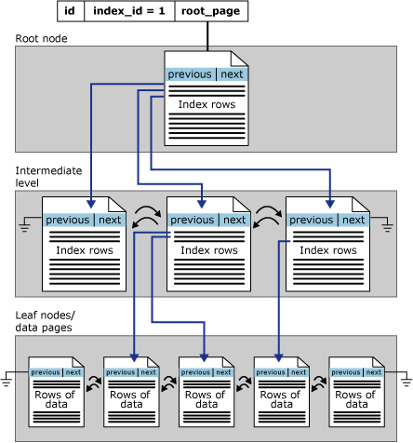
Maintaining Indexes and Statistics
Azure automation
Creating the elastic agent jobs
https://docs.microsoft.com/en-us/sql/relational-databases/sql-server-index-design-guide?view=sql-server-ver15
Notes:
Statistics maintenance
Similar to SQL Server
Automatic statistics options

Slide 11

Automation jobs
Automation Job require:
Ola Hellengren scripts/Maintenance scripts
Automation account
Download sqlserver module
Credential
Create runbook
https://www.sqlshack.com/automate-azure-sql-database-indexes-and-statistics-maintenance/
Notes:
Automation Job requires
Ola Hellengren scripts/Maintenance scripts
Automation account
Download sqlserver module
Credential
Create runbook

Slide 12
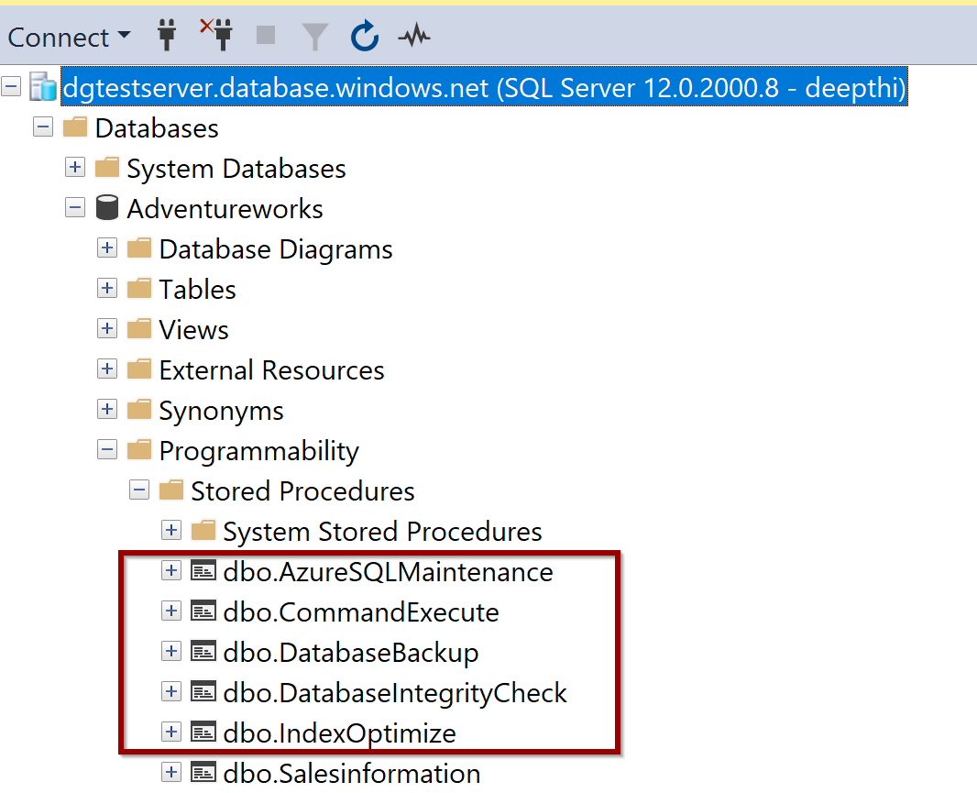
https://ola.hallengren.com/sql-server-index-and-statistics-maintenance.html

Slide 13
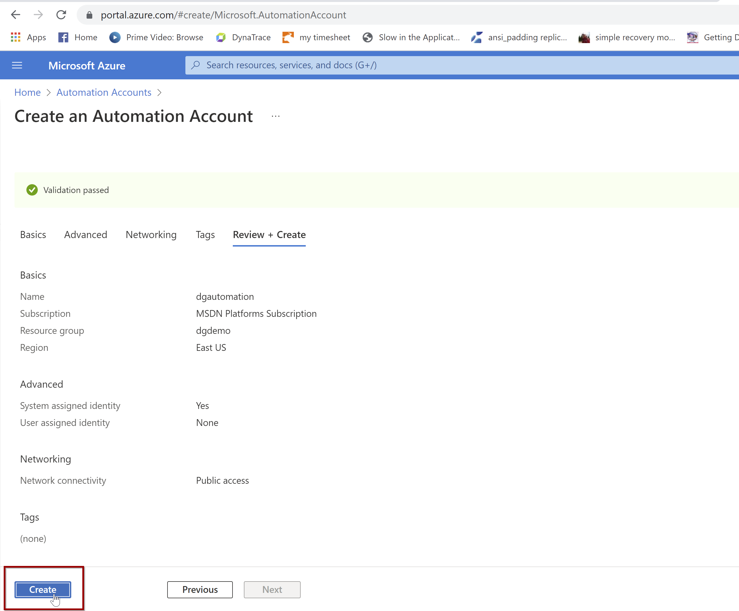

Slide 14
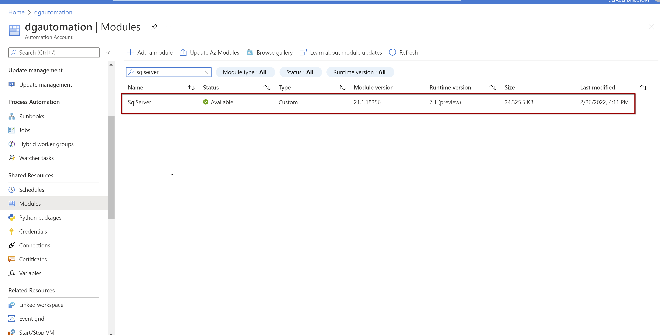

Slide 15
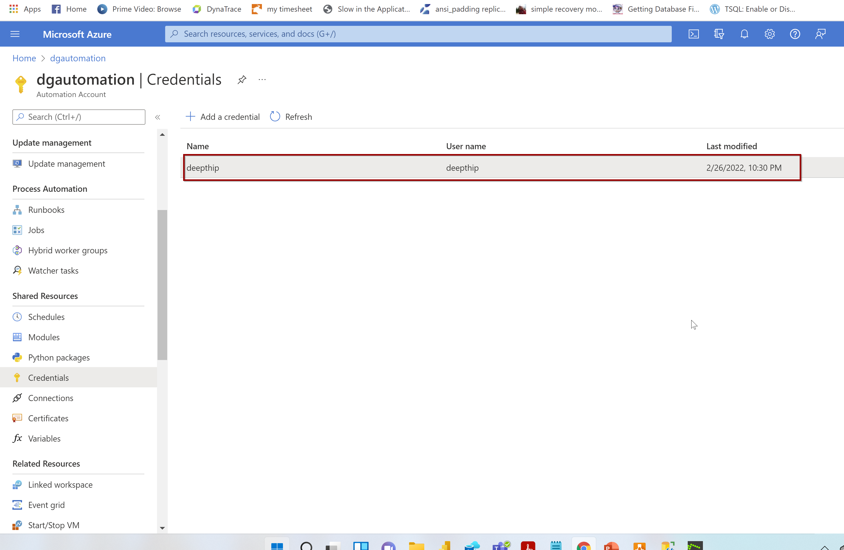

Slide 16
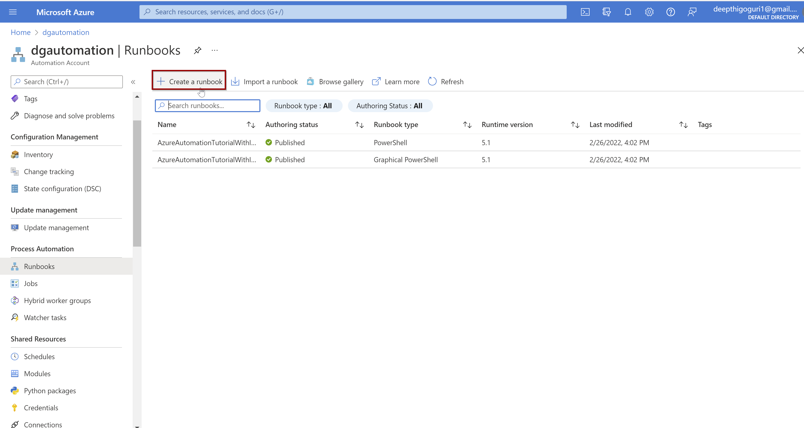

Slide 17
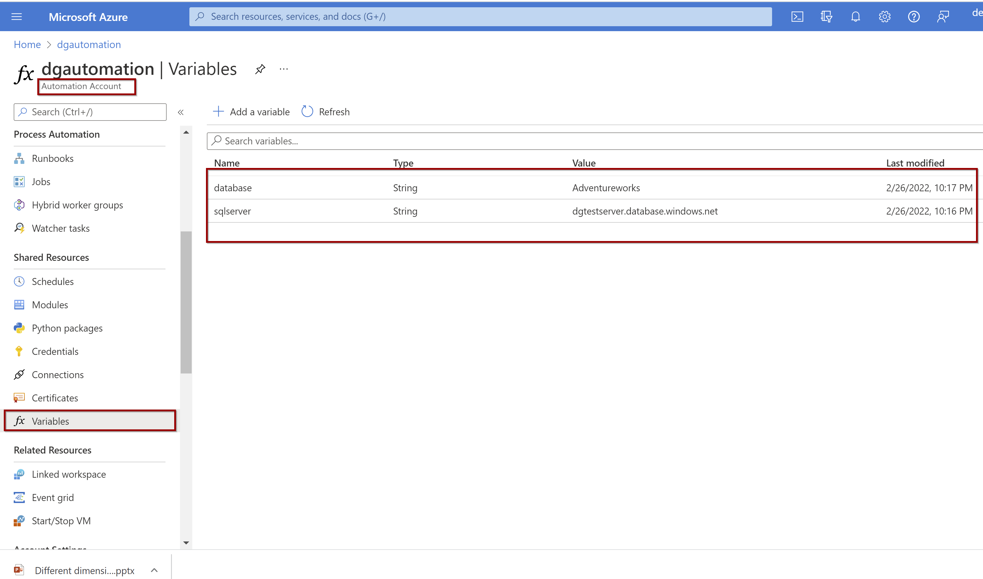

Slide 18
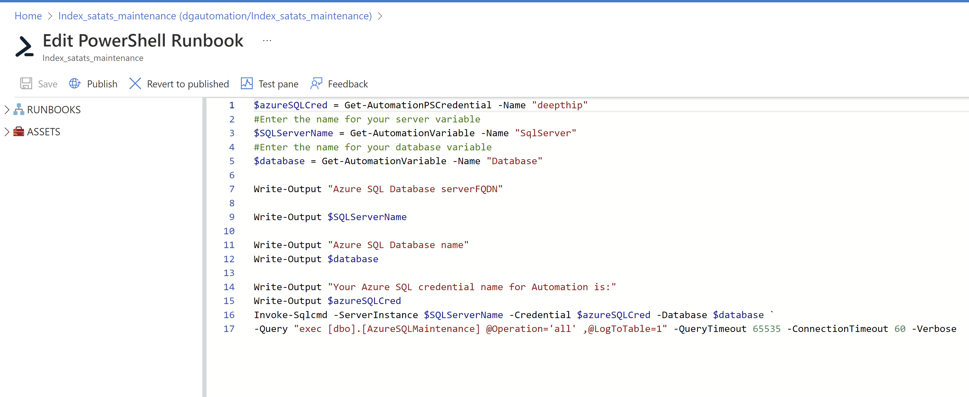

Slide 19
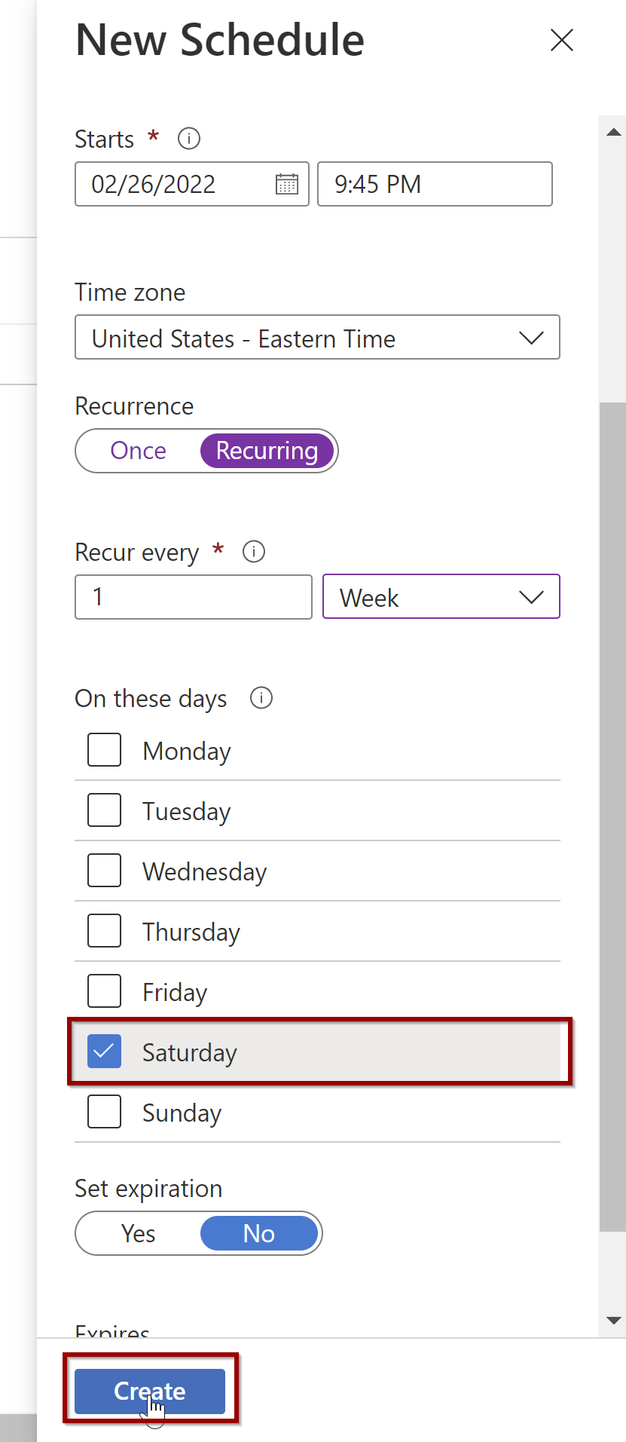

Slide 20
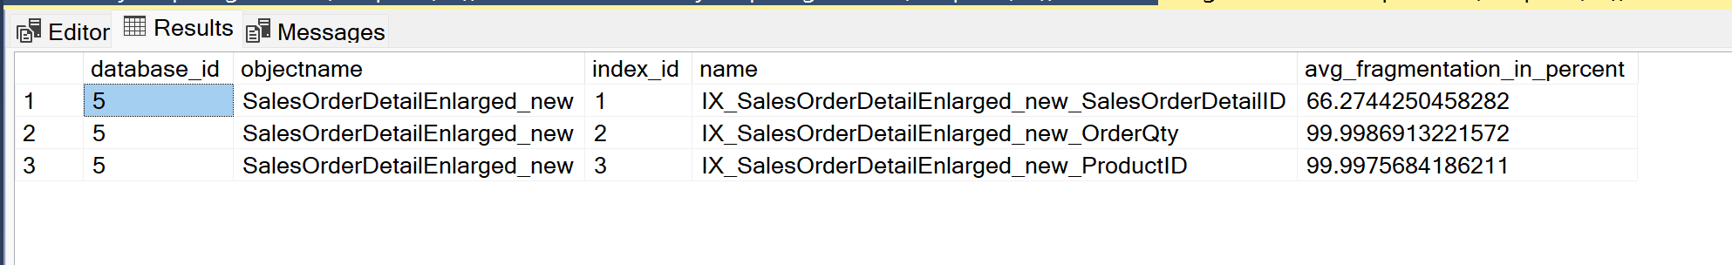
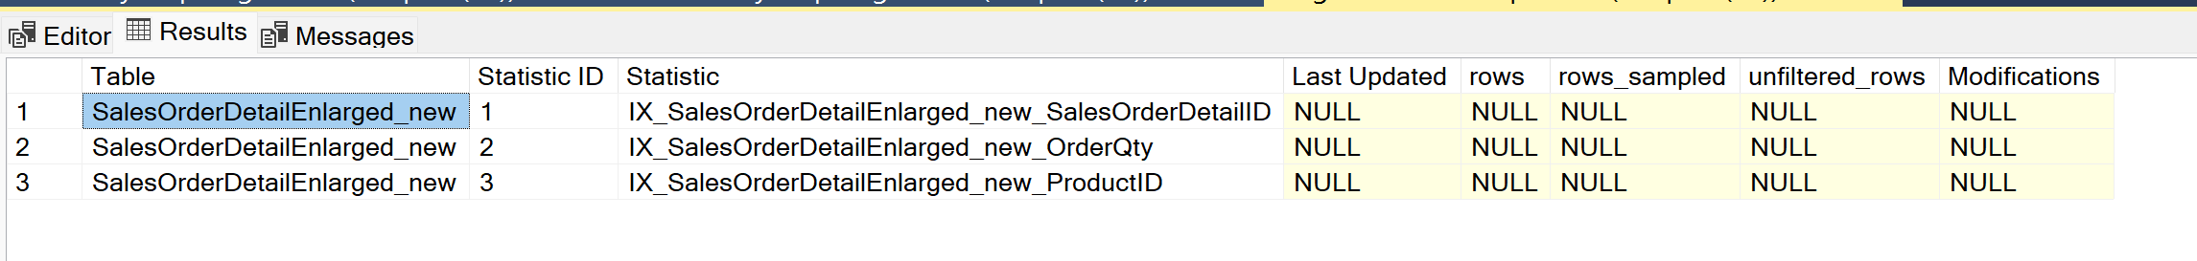
Index Fragmentation
When was my indexes lastly updated?

Slide 21
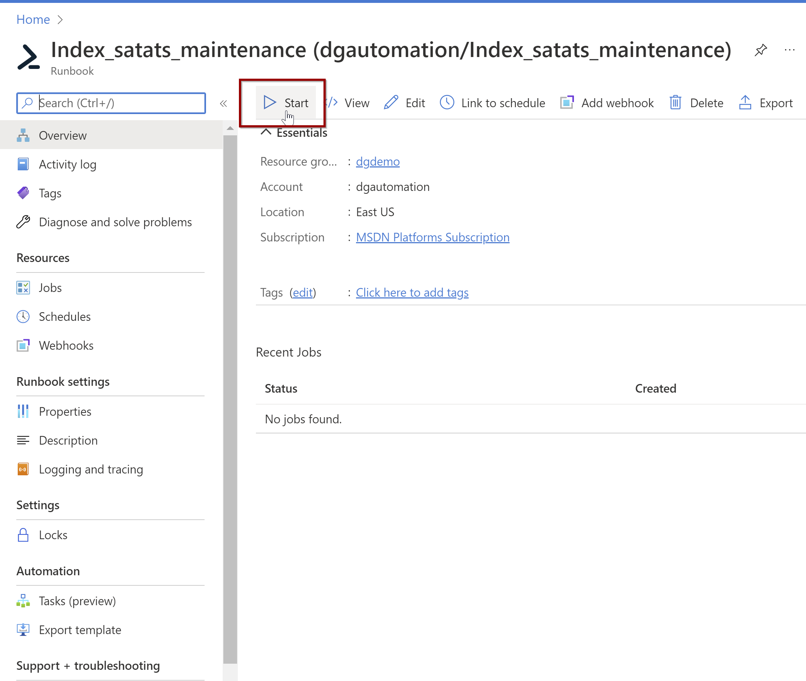

Slide 22
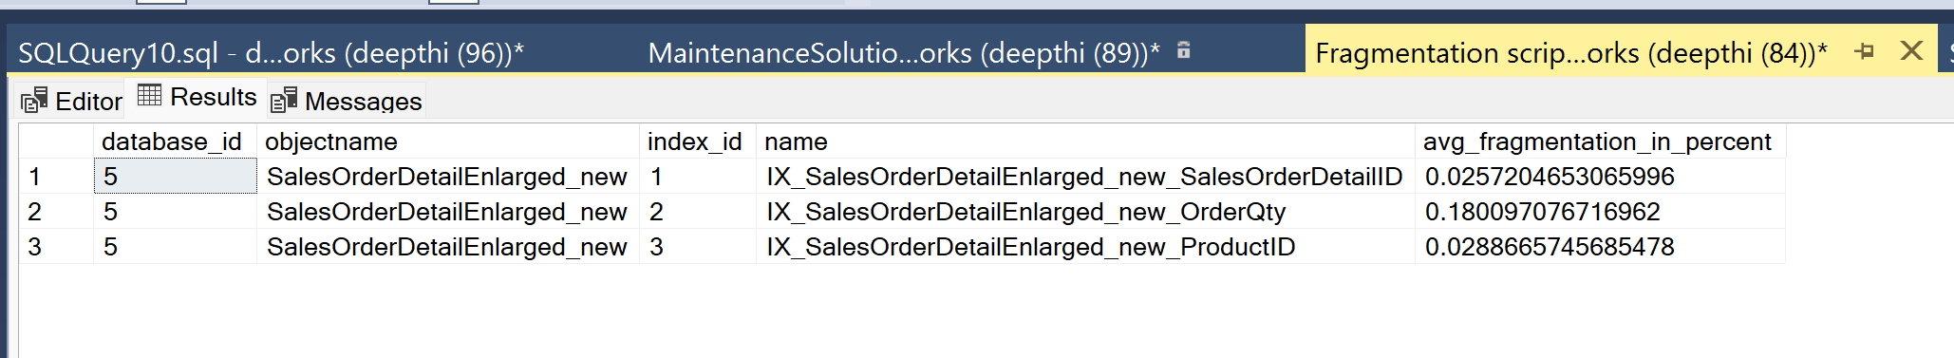
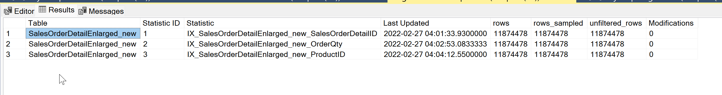
Index Fragmentation
When was my indexes lastly updated?

Slide 23
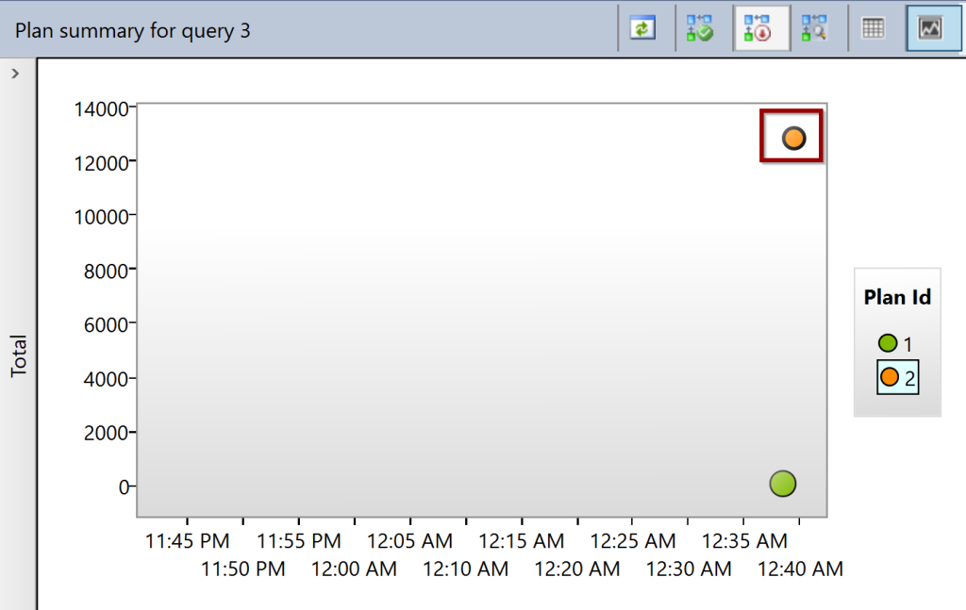
Query Store
Captures history of query plans
Option to choose optimal plan
Enabled by default (Azure SQL database)
Cannot be enabled on master or tempdb

Slide 24

Automatic plan correction
SQL Server 2017 and above
Continuous monitoring for plan regression
Adjust accordingly by forcing/un-forcing
Enable using T-SQL or using the Azure portal

Slide 25
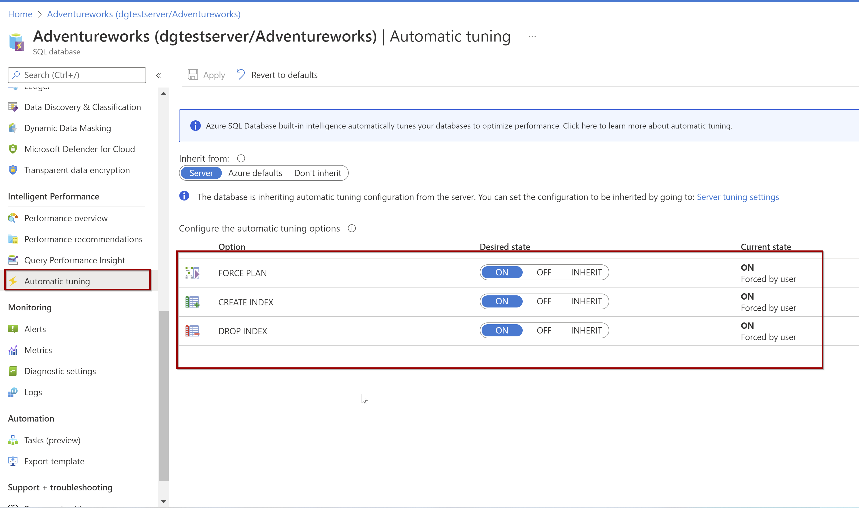
Automatic tuning- Indexes
Telemetry
Recommendations
https://techcommunity.microsoft.com/t5/azure-database-support-blog/automating-azure-sql-db-index-and-statistics-maintenance-using/ba-p/368974
Notes:
Analyzes data from the telemetry of a database, including the Query Store and DMVs.
monitors index changes, and recommends dropping or automatically drops indexes.
monitor queries over time, and use machine learning algorithms to make recommendations.
Doesn’t check for the impact on operations having inserts, updates, or deletes.

Slide 26
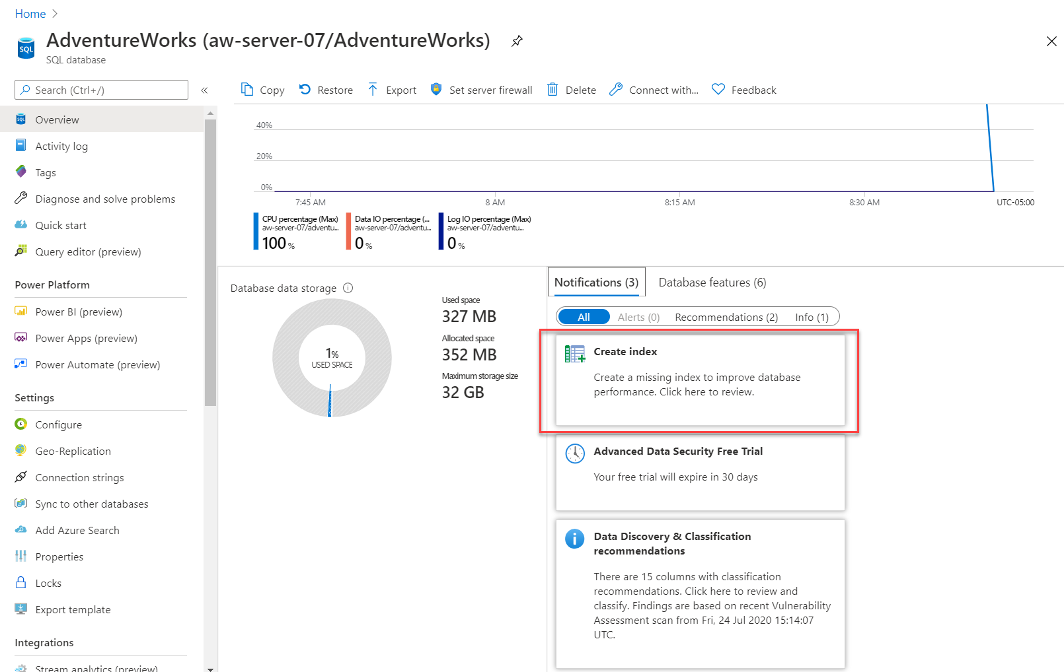
https://docs.microsoft.com/en-us/learn/modules/azure-sql-performance/9-intelligent-performance

Slide 27
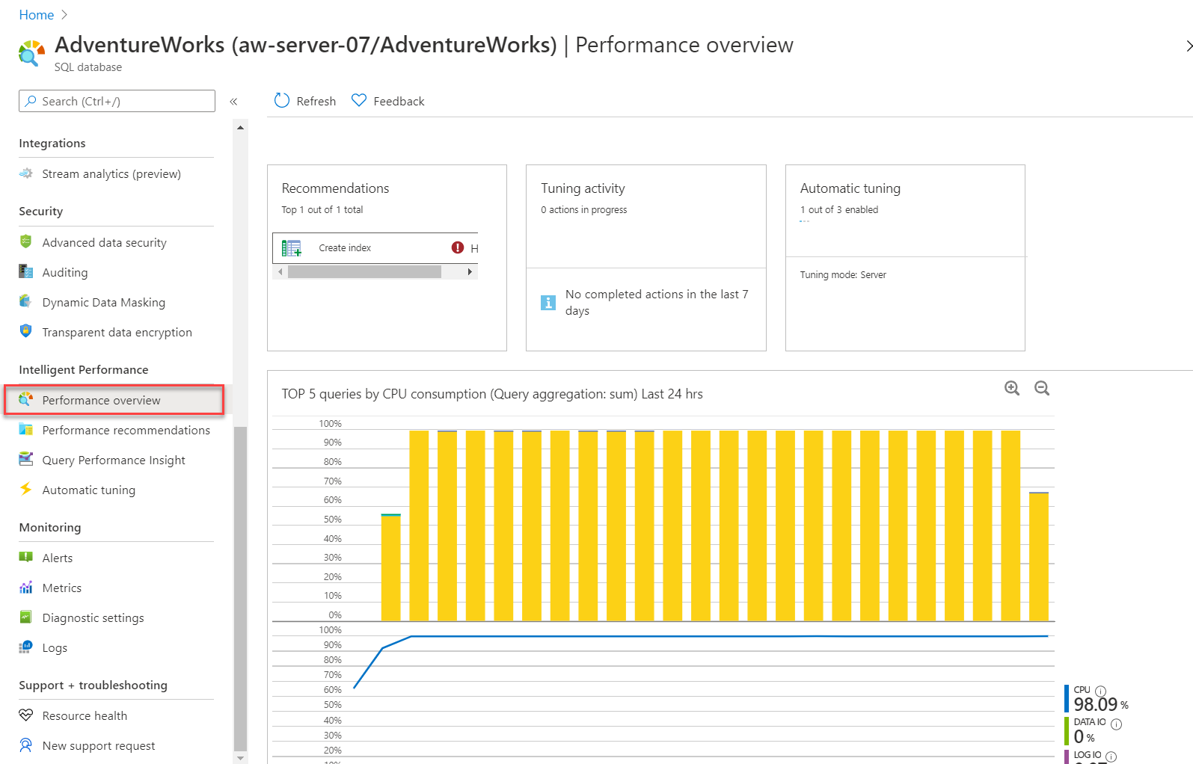
https://docs.microsoft.com/en-us/learn/modules/azure-sql-performance/9-intelligent-performance

Slide 28
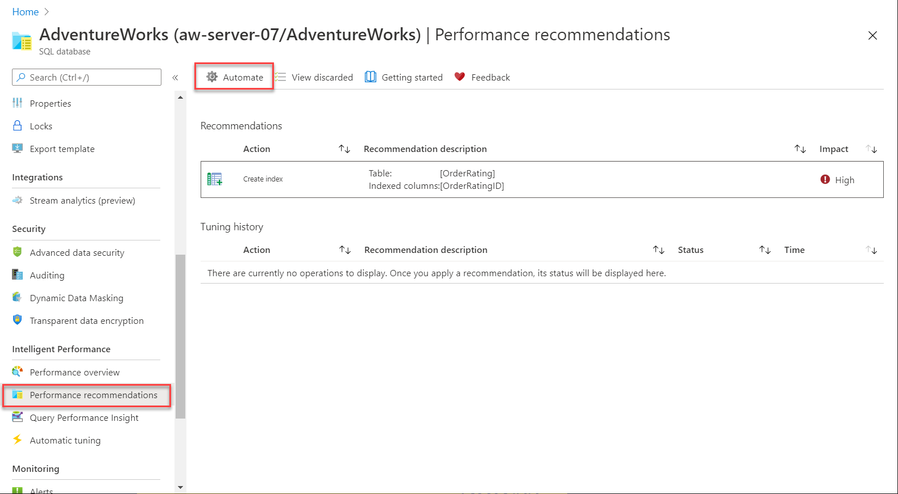
https://docs.microsoft.com/en-us/learn/modules/azure-sql-performance/9-intelligent-performance

Slide 29
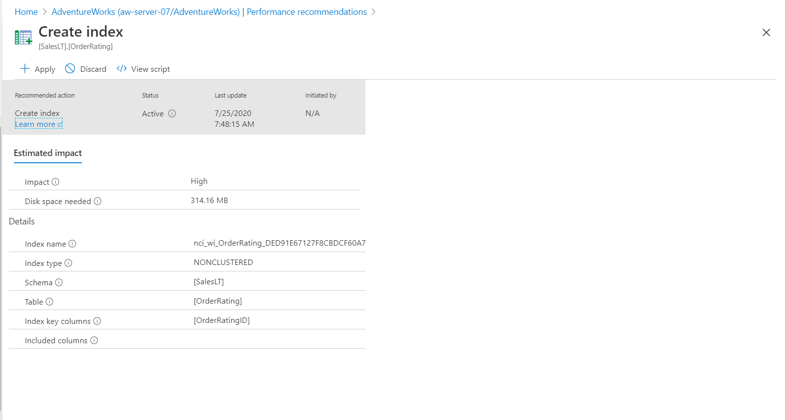
https://docs.microsoft.com/en-us/learn/modules/azure-sql-performance/9-intelligent-performance

Slide 30

Query performance Insight

Slide 31

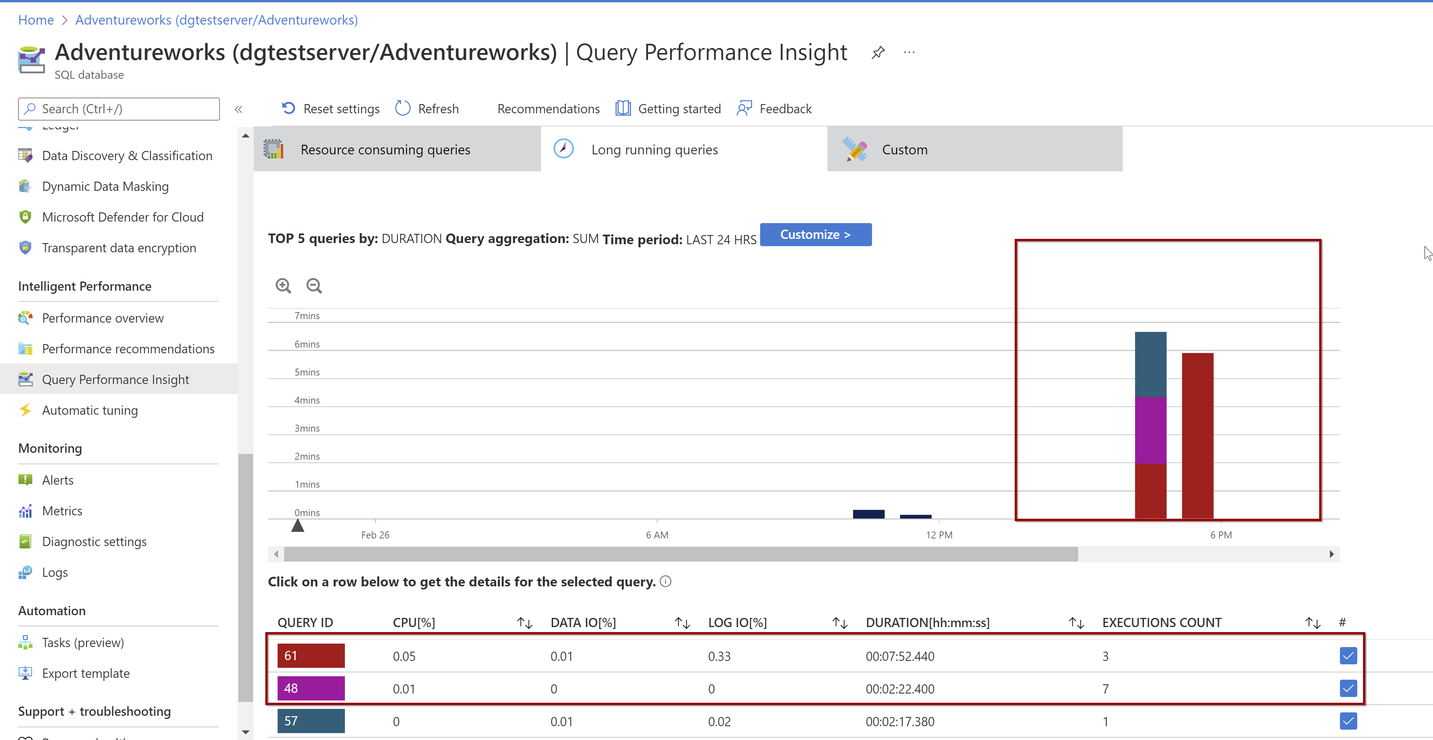

Slide 32
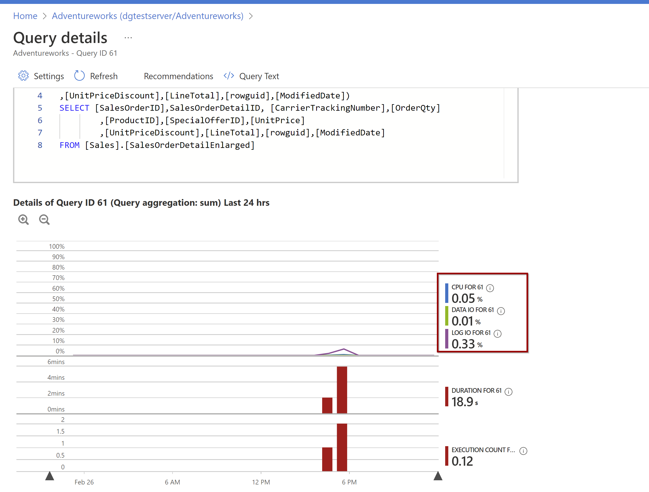

Slide 33


